Slide 2



Thanks to our sponsors

Slide 3

AI on the edge
Marco Minerva
Microsoft MVP Windows Development

Slide 4
As a developer, why should I care about AI and ML?
Notes:
Everyone in the room is a Machine Learning developer!
ML is everywhere and chances are you are already using a service that is possible through ML.
We are going to show you how AI and ML can help you solve real problems in your own apps and services and how easy it is to get started with ML today in your own apps

Slide 5




Some problems are difficult to solve using traditional algorithms and procedural programming.
Identify objects and people in photos and videos
Recommend products to your users based on historical data
Detect failures in an industrial process before they happen
Navigate autonomously around obstacles and
obey traffic laws
Notes:
Any technology user today has benefitted from machine learning.
Facial recognition technology allows social media platforms to help users tag and share photos of friends.
Recommendation engines, powered by machine learning, suggest what movies or television shows to watch next based on user preferences.
Manufacturing processes contain sensors that collect vast amounts of data and are able to predict failures and react in real time.
Self-driving cars that rely on machine learning to navigate are already being tested and may soon be available to consumers.
In our projects, we are often asked to solve very hard problems.
These three problems have something in common – they are relatively easy for a human to solve, but are difficult to program a computer to do.
This is especially true, when the only tool available for us is procedural code and traditional algorithms.
This is where AI can help!

Slide 6
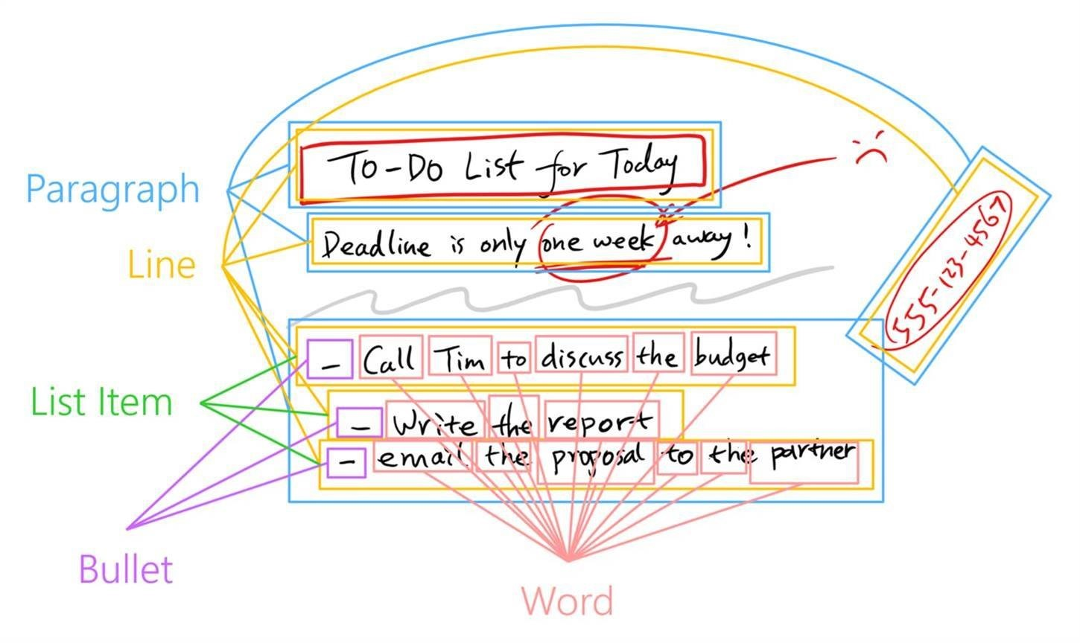
AI solves hard problems
Smart Ink​
Classify strokes as text, shapes, freehand drawings​
Classify text into words, paragraphs, lines, bullets​
Extract entities: phone numbers, names, dates​
Assign meanings: date references, known contacts
Notes:
Let me show you an example of a problem that Microsoft uses AI to solve.
Using AI techniques - the Windows Ink platform can assign conceptual meaning to physical ink strokes
Let’s look at the process:
Windows Ink can identify which ink strokes represent text
Knowing this, It can then classify that text into categories – this is a word, this is a sentence, this is a complete paragraph, this is a set of list items.
With this context, we can use ink to identify contextual entities like names, times, and phone numbers and start operating on conceptual objects like contacts and schedules.
These conceptual connections are very difficult to make without AI

Slide 7
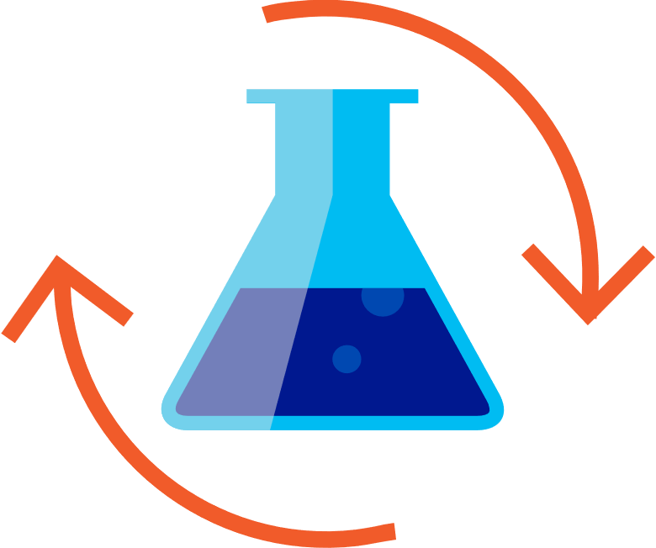

Get started with machine learning
Prepare Data
Build & Train
Evaluate
Azure Databricks
Azure Machine Learning
In the cloud – on the edge
Quickly launch and scale Spark on demand
Rich interactive workspace and notebooks
Seamless integration with all Azure data services
Broad frameworks and tools support: TensorFlow, Cognitive Toolkit, Caffe2, Keras, MxNET, PyTorch
Docker containers
Windows Machine Learning
Notes:
Let’s take a look at the end-to-end cycle of creating and using machine learning models.
At Microsoft, we’ve been investigating AI solutions for a while, and we’ve worked with developers across industries who use AI solutions.
Many of Microsoft’s AI investments are in the Azure Cloud:
Machine Learning is a power tool to help us answer specific questions. We need to understand what question we’re striving to bring clarity to. Once we’ve defined the question we want to answer, we must identify a set of labelled data which can help us answer this question. Azure Databricks combines the best of Databricks and Azure to help customers accelerate innovation with one-click set up, streamlined workflows, and an interactive workspace that enables collaboration between data scientists, data engineers, and business analysts.
Azure Machine Learning allows you to use broad frameworks and tools to build and train the model, including frameworks such as TensorFlow, Cognitive Toolkit, PyTorch and more. It allows you to scale training to 100Ks servers and use –prebuilt AI model packages for Computer Vision, Text, and forecasting
Once you’ve trained a model, you can deploy it to a service to use from the cloud or use it locally on the Edge.
For the rest of this talk, we will focus on using pre-trained models on the Edge and on Windows

Slide 8
AI on the edge
Low latency
Scalability
Flexibility
Notes:
Azure AI solutions can really help you use AI to solve your hard problems, but sometimes developers also need AI Capabilities on the Edge.
Low Latency
When scenarios require real-time, low latency results. This is critical, when your analyzing images in a video, running AI in a game engine, or handling background tasks like search.
Scalability
When you already have a service that’s running at scale, AI on the edge enables you to add intelligence to your service while optimizing your operational cost. You are not paying for GPU usage for every AI operation, but one for AI training.
Flexibility
Moving AI processing to the device is really important when data can't be sent to the cloud - due to poor connection, size, policy, or simple customer preference.

Slide 9
Introducing Windows ML
Notes:
In the Windows 10 April 2018 Update, we released Windows ML:
A powerful API that enables developers to evaluate pre-trained machine learning models on the edge, using the hardware resources on the local machine.
Microsoft uniquely offers an AI platform from the Intelligent Cloud to the Intelligent Edge, that is optimized at the silicon level.
Let me show you how

Slide 10
Hello WinML!
Notes:
Demo 1. Evaluate existing model in a new UWP app
Let me show you how easy it is to use a pre-existing model in your apps. [Follow Getting started with WinML and Emotion model demo instructions found in demo repository on GitHub: https://github.com/Microsoft/InsiderDevTour18-ML
Demo 2. Emoji - Have app installed from the store: https://www.microsoft.com/en-us/store/p/emoji8/9n5vj4hkp6x1?rtc=1&activetab=pivot%3aoverviewtab
The app is using the same model we showed in the previous demo. It uses Windows ML to evaluate a user's facial expressions when given an emoji to imitate.
[Invite a member from the audience to come on stage to try it out and explain what is happening while playing with the app.]

Slide 11
Windows ML solves three problems for you
UWP App
Developers can focus on their data and their scenarios, using Windows ML for model evaluation
Enables using ML models trained with a diverse set of toolkits
Hardware acceleration gets fast evaluation results across the diversity of the entire Windows device ecosystem.
Win32 App
WinML UWP API
WinML Win32 API
WinML Runtime
Model Inference Engine
DirectML
Direct3D
CPU
GPU
Notes:
Let me explain how Windows ML solved 3 problems for me when building an application like the one I just showed you
Windows ML provides an evaluation runtime, so you don’t have to worry about finding one and deploying it with your application. Just focus on identifying your question, gathering your data – and let Windows ML provide the platform. Likewise, Windows ML provides me with APIs that I can use in either my Win32 application, or my UWP application
Windows ML supports ONNX, the industry standard for Machine Learning model interop. No matter what training framework you used to make your model, as long as you can save or convert it into ONNX – you can evaluate it with Windows ML.
On Windows, your evaluation code is HW accelerated using DX12. DirectX as you know, has a proven history of providing excellent performance across a wide range of hardware. This means that you don’t have to change your code when running on different devices.
This is a huge advantage compared to other platforms that depend on 3rd party device SDKs for evaluation acceleration. We’ve also optimized the CPU paths, using the instruction optimizations up to AVX-512.

Slide 12
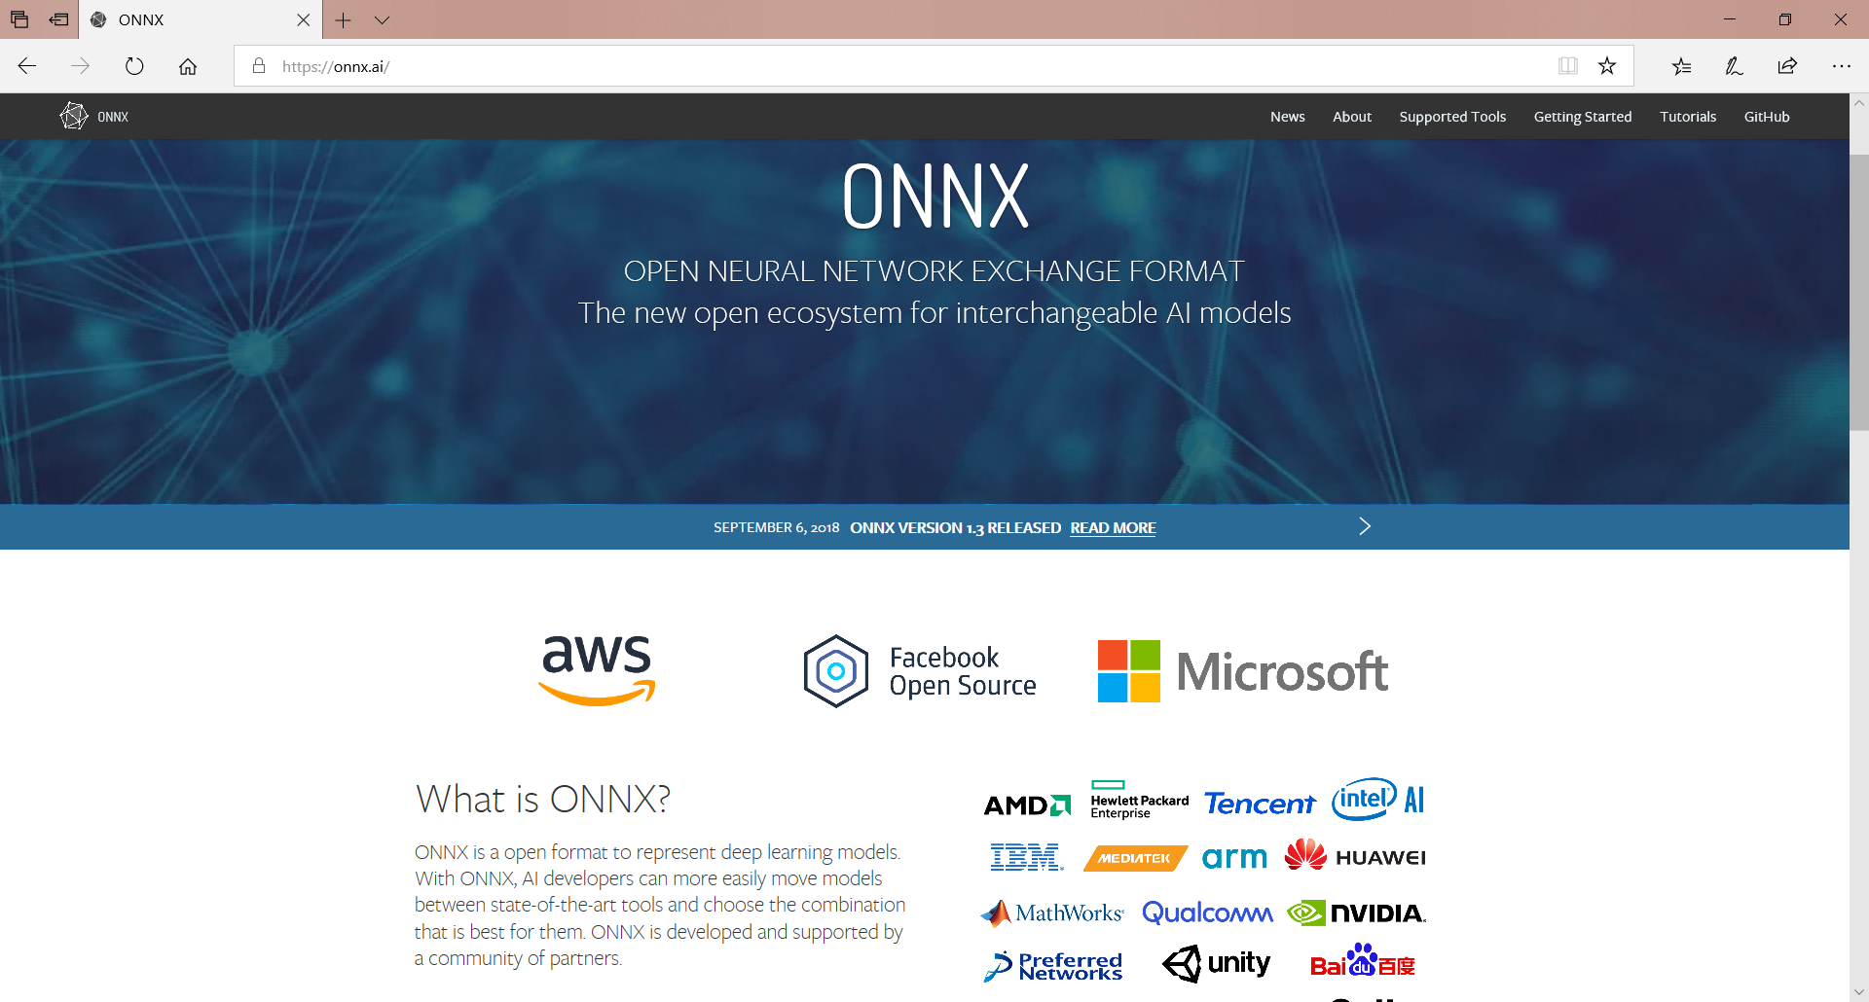
Notes:
Industry standard format for Machine Learning model interchange
A community project created by Microsoft and Facebook
Defines an extensible computation graph, built-in operators, and standard data types.
Supports a wide range of machine learning models including Classical and Deep Learning algorithms
Learn more at https://onnx.ai/

Slide 13
How do I get ONNX models to use in my application?
Azure AI Gallery curates models for use with Windows ML - https://gallery.azure.ai/models
Azure Machine Learning Services gives you an end-to-end solution to prepare data, and train your model in the Cloud.
WinMLTools converts existing models from CoreML, scikit-learn, LIBSVM, and XGBoost
Azure Custom Vision makes it easy to create your own image models - https://customvision.ai
Notes:
Azure Machine Learning Services gives you an end-to-end solution to prepare data, and train your model in the Cloud.
Just modify your training scripts to save an ONNX file.
WinMLTools converts existing models from CoreML, scikit-learn, LIBSVM, and XGBoost
WinMLTools is a python package that you can pip install to perform conversions.

Slide 14
Azure Custom Vision
Notes:
Follow CustomVision and AlarmML demo steps found in the demo repository on Github: https://github.com/Microsoft/InsiderDevTour18-ML

Slide 15
More edges with Custom Vision

Slide 16
Custom Vision models targets
CoreML
iOS 11 & later
TensorFlow
Android
ONNX
Windows ML
Dockerfile
Azure IoT Edge, Azure Functions, AzureML

Slide 17
AI on Raspeberry Pi with Docker

Slide 18
Modify files to make things work
Dockerfile: add the following
RUN pip install https://github.com/lhelontra/tensorflow-on-arm/releases/download/v1.5.0/tensorflow-1.5.0-cp35-none-linux_armv7whl
app/requirements.txt: remove the following
tensorflow==1.5.0
https://gist.github.com/marcominerva/74ab33bef3660bb9a0f6db2f6cebd97b

Slide 19
Custom Vision offline models with iOS & Android

Slide 22
Demo intro slide

Slide 23
Code Sample Title

Slide 24
References
https://onnx.ai
https://gallery.azure.ai/models
Emoji8: https://www.microsoft.com/en-us/store/p/emoji8/9n5vj4hkp6x1
https://customvision.ai
https://github.com/DotNetToscana/DotNetConf2018
https://github.com/DotNetToscana/CustomVisionCompanion

Slide 25
Thanks!
Questions?
https://github.com/marcominerva
@marcominerva
https://linkedin.com/in/marcominerva

